Slide 1
DATA SCIENCE REVIEW

Slide 2
X. Neural Networks XI. Recommenders XII. Categorical Variables XiII. Model Eval. Procedures XIV. Model Eval. Metrics XV. Unsupervised Learning XVI. Cluster Analysis XVII. Dimension Reduction
agenda
I. Data Science Workflow iI. Supervised Learning III. K-Nearest Neighbors IV. Linear regression V. Logistic Regression VI. Naïve Bayes VII. Decision Trees
VIII. Random Forests IX. AdaBoost

Slide 3
I. Data Science Workflow
DATA SCIENCE

Slide 4
The data Science WORKFLOW
I. Define the problem / question
II. Identify and collect data
III. Explore and prepare data
IV. Build and evaluate model
V. Communicate results

Slide 5
II. Supervised learning
DATA SCIENCE

Slide 6
Types of Machine Learning Problems
generalization
supervised making predictions
unsupervised extracting structure
representation

Slide 7
Types of Machine Learning Problems
continuous categorical
supervised regression classification
unsupervised dimension reduction clustering

Slide 8
Supervised Learning
Objectives of Supervised Learning:
Accurately predict unseen test cases
Understand which predictors affect the response, and how
Assess the quality of our predictions

Slide 9
Supervised Learning
Vector of “Predictors” X
Also known as features, independent variables, inputs, regressors, covariates, attributes
“Response” y
Also known as outcome, label, target, dependent variable
Regression: y is continuous
e.g., price, blood pressure
Classification: y is categorical (values in a finite, unordered set)
e.g., spam/ham, digit 0-9, cancer class of tissue sample
Data is composed of “observations” (predictors and the associated response)
Also known as samples, examples, instances, records

Slide 10
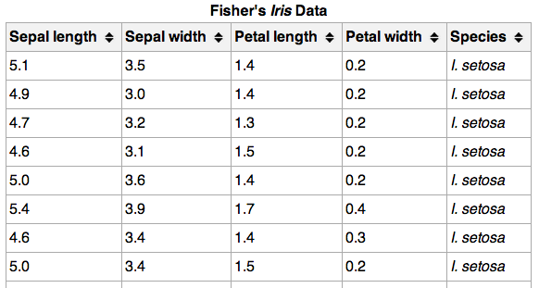
Supervised Learning
}
{
150 observations
(n = 150)
{
response
4 predictors (p = 4)

Slide 11
III. K-Nearest Neighbors
DATA SCIENCE

Slide 12
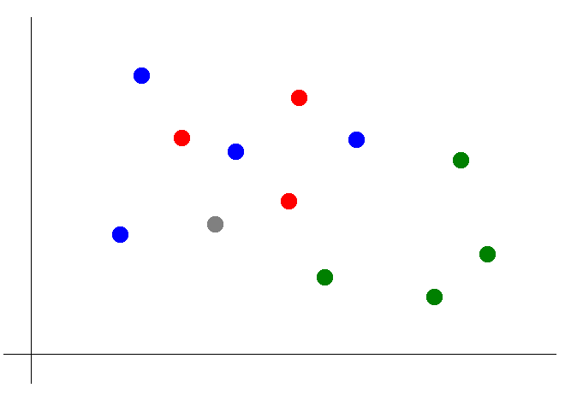
Classification with KNN
Suppose we want to predict the color of the gray dot.
1) Pick a value for k.
2) Find colors of k nearest neighbors.
k = 3

Slide 13
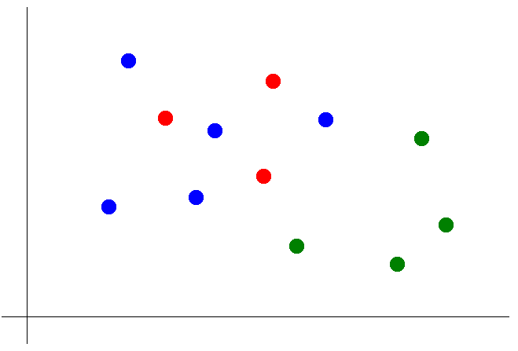
Classification with KNN
Suppose we want to predict the color of the gray dot.
1) Pick a value for k.
2) Find colors of k nearest neighbors.
3) Assign the most common color
to the gray dot.

Slide 14
IV. Linear Regression
DATA SCIENCE

Slide 15
Linear Regression
Q: What is a regression model?
A: A functional relationship between input & response variables.
The simple linear regression model captures a linear relationship between a single input variable x and a response variable y:
y = α + β x + ε

Slide 16
Linear Regression
Q: What do the terms in this model mean?
y = α + β x + ε
A: y = response variable (the one we want to predict)
x = input variable (the one we use to train the model)
α = intercept (where the line crosses the y-axis)
β = regression coefficient (the model parameter)
ε = residual (the error)

Slide 17
Linear Regression
We can extend this model to several input variables, giving us the multiple linear regression model:
y = α + β ₁x₁ + … + β _{n}x_{n} + ε

Slide 18
Linear Regression
Q: How to estimate coefficients for a linear model?
A: By finding the line that minimizes the sum of squared residuals.
Model Prediction
y
Observed Result
x

Slide 19
V. Logistic Regression
DATA SCIENCE

Slide 20
Logistic Regression
Q: What is logistic regression?
A: A generalization of the linear regression model to classification problems.

Slide 21
Logistic Regression
In linear regression, we used a set of input variables to predict the value of a continuous response variable.
In logistic regression, we use a set of input variables to predict probabilities of class membership.
These probabilities can then mapped to class labels, thus predicting the class for each observation.

Slide 22
Logistic Regression
When performing linear regression, we use the following function:
When performing logistic regression, we use the following form:
Probability of y = 1, given x

Slide 23
Logistic Regression
In linear regression, the parameter β₁ represents the change in the response variable for a unit change in x.
In logistic regression, β₁ represents the change in the log-odds for a unit change in x.
This means that gives us the change in the odds for a unit change in x.

Slide 24
Logistic Regression
Example: Suppose we are interested in mobile purchase behavior. Let y be a class label denoting purchase/no purchase, and let x denote whether phone was an iPhone.
We perform a logistic regression, and we get β₁ = 0.693.
In this case the odds ratio is exp(0.693) = 2, meaning the likelihood of purchase is twice as high if the phone is an iPhone.

Slide 25
VI. Naïve Bayes
DATA SCIENCE

Slide 26
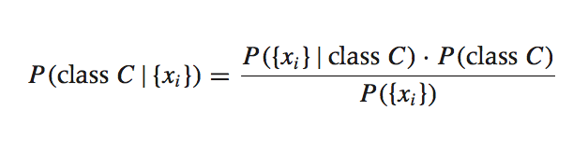
Bayesian inference
Suppose we have a dataset with features x₁, …, x_{n} and a class label C. What can we say about classification using Bayes’ theorem?
Bayes’ theorem can help us to determine the probability of a record belonging to a class, given the data we observe.
source: Data Analysis with Open Source Tools, by Philipp K. Janert. O’Reilly Media, 2011.

Slide 27
Bayesian inference
This term is the posterior probability of C. It represents the probability of a record belonging to class C after the data is taken into account.
The goal of any Bayesian computation is to find (“learn”) the posterior distribution of a particular feature. This constitutes the training phase of the model.

Slide 28
Bayesian inference
The idea of Bayesian inference, then, is to update our beliefs about the distribution of C using the data (“evidence”) at our disposal.
Then we can use the posterior for prediction.

Slide 29
VII. Decision Trees
DATA SCIENCE

Slide 30
What are decision trees?
A supervised learning technique that can be used for discrete and continuous output.
Visually engaging and easy to interpret.
Excellent model for someone transitioning into the world of data science.
Foundational to learning some very powerful techniques.
Are prone towards high-variance.
We will focus on the CART algorithm.

Slide 31
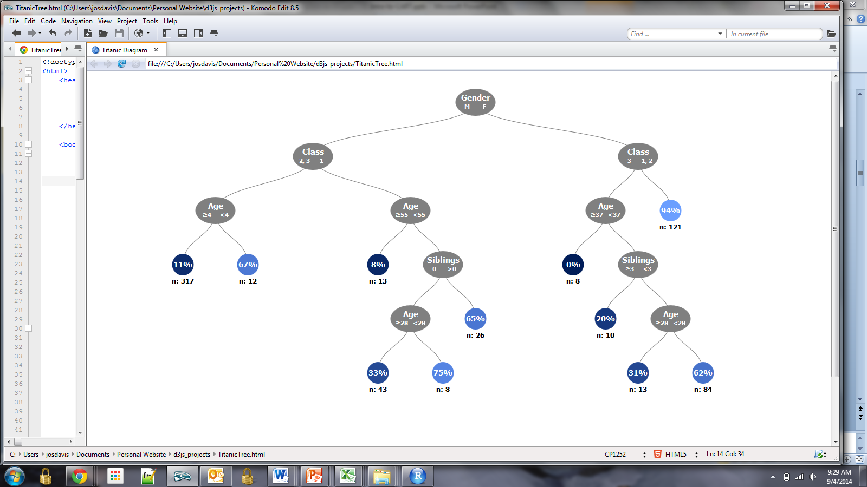
Description
Decision Trees are made up of interconnected nodes, which act as a series of questions / test conditions (e.g., is the passenger male or female?)

Slide 32
Description
Terminal nodes show the output metric, in this case the percentage of titanic survivors for a given combination of variables.

Slide 33
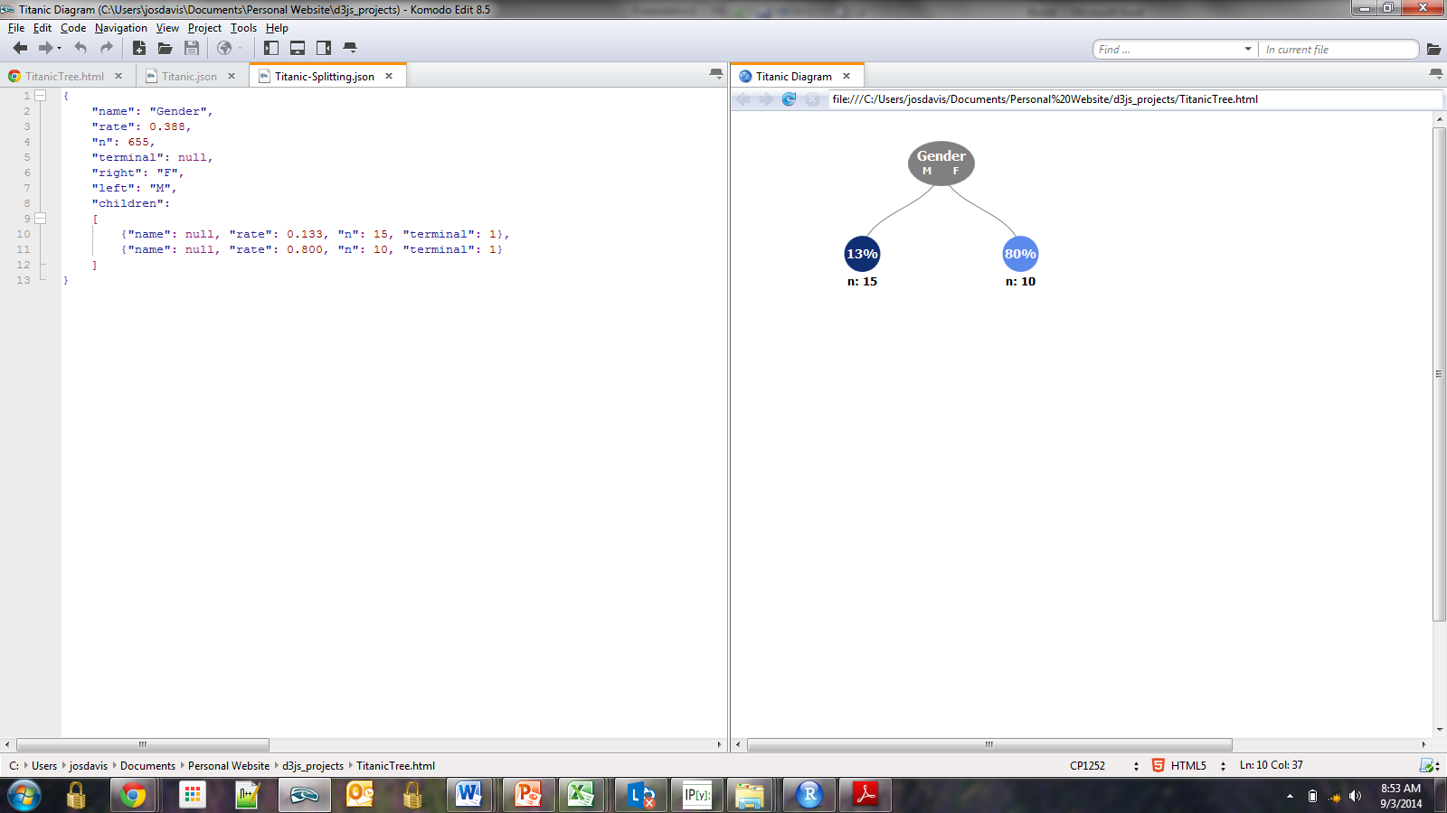
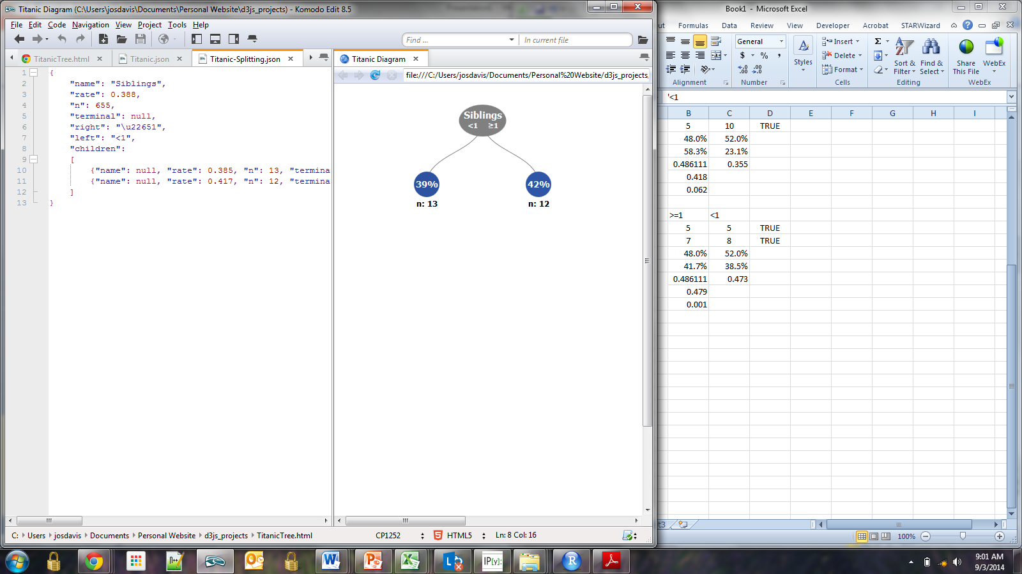
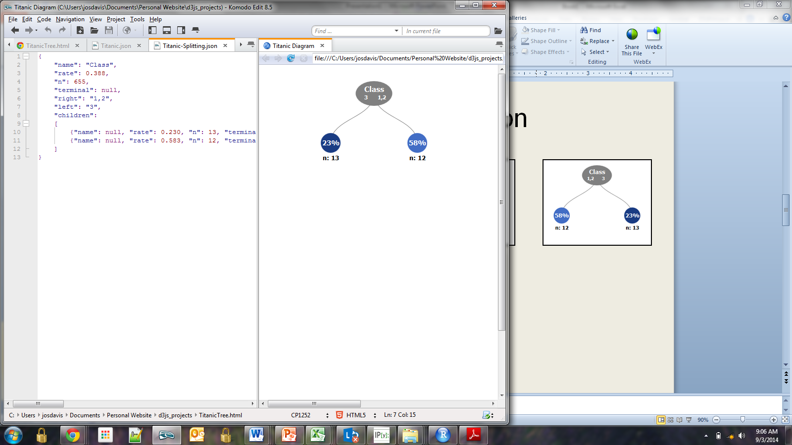
The Algorithm, Introduced
Different variables and split options are evaluated to determine which split will provide the greatest separation between classes.
Which split option would you select?
How can we determine the best split analytically?

Slide 34
The Algorithm – Overview
Calculate the purity of the data
Select a candidate split
Calculate the purity of the data after the split
Repeat for all variables
Choose the variable with the greatest increase in purity
Repeat for each split until some stopping criteria is met

Slide 35
Meta-Evaluation
Advantages:
The nature of its output provides the decision tree algorithm with a degree of interpretability that other more complex algorithms don’t provide
Understanding how the decision Tree works is foundational to understanding how more complex, and widely-used models work, such as random forests and boosted trees.
Disadvantages:
The decision Tree tends to perform worse than more sophisticated modeling techniques due to their instability

Slide 36
VIII. Random Forests
DATA SCIENCE

Slide 37
Random Forests
Definition of Random Forests:
“Each new training set is drawn, with replacement, from the original training set. Then a tree is grown on the new training set using random feature selection. The trees grown are not pruned.”

Slide 38
Random Forests
Q: Why are trees not pruned?
A: To increase variance (i.e., model diversity). Variance is good because it means we have different trees. Remember how this was a disadvantage we discussed of CART? Well, now this is a key feature that makes enables the Random Forest to be so powerful.

Slide 39
Random Forests
Benefits of Random Forests:
Its accuracy is as good as AdaBoost and sometimes better.
It's relatively robust to outliers and noise.
It's faster than bagging or boosting.
It gives useful internal estimates of error, strength, correlation and variable importance.
It's simple and easily parallelized.

Slide 40
IX. AdaBoost
DATA SCIENCE

Slide 41
AdaBoost
The core principle of AdaBoost is to fit a sequence of weak learners (i.e., models that are only slightly better than random guessing, such as small decision trees) on repeatedly modified versions of the data.
The predictions from all of them are then combined through a weighted majority vote (or sum) to produce the final prediction.

Slide 42
AdaBoost
The data modifications at each so-called boosting iteration consist of applying weights to each of the training samples. For each successive iteration, the sample weights are individually modified and the learning algorithm is reapplied to the reweighted data…
As iterations proceed, examples that are difficult to predict receive ever-increasing influence. Each subsequent weak learner is thereby forced to concentrate on the examples that are missed by the previous ones in the sequence.

Slide 43
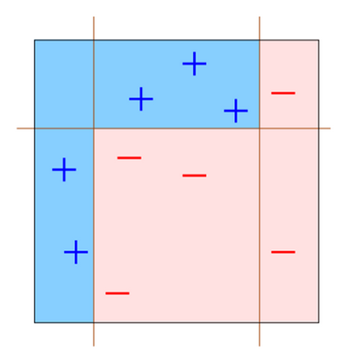
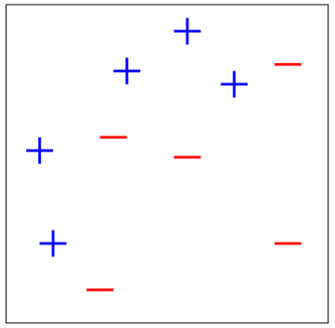
AdaBoost

Slide 44
X. Neural Networks
DATA SCIENCE

Slide 45
Representation
Artificial neural networks are represented as a system of interconnected neurons with multiple layers.

Slide 46
Input Layer
Input neurons represent the features of the dataset.
Input
Neurons

Slide 47
Output Layer
For supervised learning, the output neuron represents the response variable(s).
Input
Neurons
Output
Neurons

Slide 48
Hidden Layers
Hidden layer are what allow the network to fit highly non-linear patterns.
Input
Neurons
Hidden
Neurons
Output
Neurons

Slide 49
Weights
Connections between nodes are defined by a weight value which determines the influence of one neuron on another.

Slide 50
Gradient Descent - Intuition
Weights are updating according to an algorithm called the gradient descent, an iterative procedure for finding the optimal parameters for a given model.

Slide 51
Meta-Evaluation
Advantages:
Neural networks give amazing flexibility to fit complex and non-linear functions
For this reason, Neural networks can produce impressive predictive results that exceed any of the algorithms we have previously learned
Disadvantages:
Neural networks can be computationally expensive, requiring a lot of time / processing power
Neural networks function as a “black box” with low interpretive value

Slide 52
XI. Recommenders
DATA SCIENCE

Slide 53
Recommendation systems
A recommendation system will predict a rating that a user will give an item that they have not yet rated.
This rating is produced by analyzing other user/item ratings (and sometimes item characteristics) to provide personalized recommendations to users.

Slide 54
Recommendation systems
There are two general approaches to recsys design:
In content-based filtering, items are mapped into a feature space, and recommendations depend on item characteristics.
In contrast, the only data under consideration in collaborative filtering are user-item ratings, and recommendations depend on user preferences.

Slide 55
content-based filtering
Content-based filtering has some difficulties:
- need to map each item into a feature space (usually by hand!)
- recommendations are limited in scope (items must be similar to each other)
- hard to create cross-content recommendations (eg books/music
films…this would require comparing elements from different feature
spaces!)

Slide 56
Collaborative filtering
Collaborative filtering refers to a family of methods for predicting ratings where instead of thinking about users and items in terms of a feature space, we are only interested in the existing user-item ratings themselves.
The idea is that users get value from recommendations based on other users with similar tastes.

Slide 57
XII. Categorical Variables
DATA SCIENCE

Slide 58
CATEGORIAL VARIABLES
Q: How do we deal with categorical variables? (i.e., with k levels)
A: Create a k-1 binary (“dummy”) variables.
Major (k=4)
Computer Science
Engineering
Business
Literature
Business
Engineering
Engineering | Business | Literature
0 | 0 | 0
1 | 0 | 0
0 | 1 | 0
0 | 0 | 1
0 | 1 | 0
1 | 0 | 0
Computer Science is the reference

Slide 59
CATEGORIAL VARIABLES
Q: Why k-1 and not k?
A: Because k-1 captures all possible outputs, and to avoid multicollinearity.
Q: Does it matter which factor level I leave out?
A: Yes, this is the reference point for all other factor levels.
Q: Is this a limitation?
A: Not really, a comparison must have a baseline.

Slide 60
XIII. Model Evaluation Procedures
DATA SCIENCE

Slide 61

Training error
Q: What’s wrong with training error?
Thought experiment:
Suppose we train our model using the entire dataset.
Q: How low can we push the training error?
We can make the model arbitrarily complex (effectively
“memorizing” the entire training set).
A: Down to zero!
A: Training error is not a good estimate of accuracy beyond training data.
NOTE
This phenomenon
is called
overfitting.

Slide 62
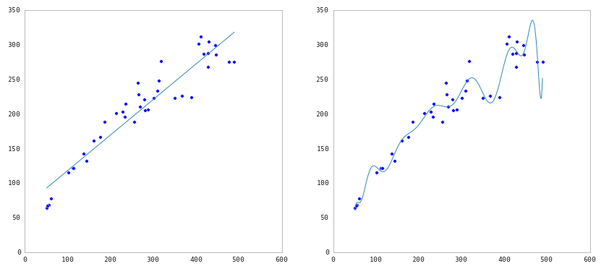
Underfitting and Overfitting
Source: http://nbviewer.ipython.org/github/fonnesbeck/Bios366/blob/master/notebooks/Section6_3-Model-Selection-and-Validation.ipynb

Slide 63



Test Set Approach
Q: How can we make a model that generalizes well?
1) split dataset
2) train model
3) test model
4) parameter tuning
5) choose final model
6) train on all data
7) make predictions
NOTE
This new data is called out of sample data. We don’t know the labels for these OOS records!
We want to estimate OOS prediction error so we know what to expect from our model.
training set
model
test set
new data
dataset

Slide 64
Test Set error
Suppose we do the train/test split.
Q: How well does test set error predict OOS accuracy?
Thought experiment:
Suppose we had done a different train/test split.
Q: Would the test set error remain the same?
A: Of course not!
A: On its own, not very well.
NOTE
The test set error gives a high-variance estimate of OOS accuracy.

Slide 65
Test Set error
Something is still missing!
Q: How can we do better?
Thought experiment:
Different train/test splits will give us different test set errors.
Q: What if we did a bunch of these and took the average?
A: Now you’re talking!
A: Cross-validation.

Slide 66
Cross-validation
Steps for K-fold cross-validation:
1) Randomly split the dataset into K equal partitions.
2) Use partition 1 as test set & union of other partitions as training set.
3) Calculate test set error.
4) Repeat steps 2-3 using a different partition as the test set at each iteration.
5) Take the average test set error as the estimate of OOS accuracy.

Slide 67
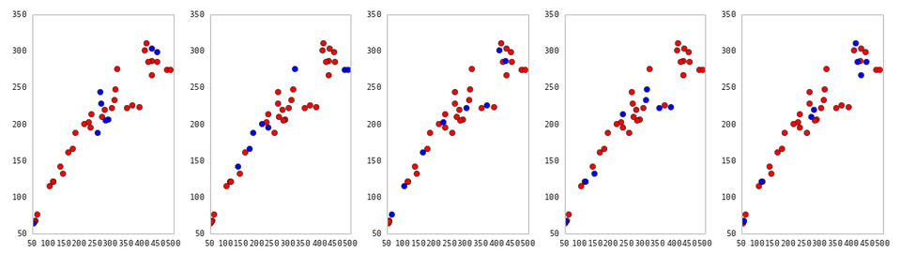
Cross-Validation
5-fold cross-validation: red = training folds, blue = test fold
Source: http://nbviewer.ipython.org/github/fonnesbeck/Bios366/blob/master/notebooks/Section6_3-Model-Selection-and-Validation.ipynb

Slide 68
Cross-validation
Features of K-fold cross-validation:
1) More accurate estimate of OOS prediction error.
2) More efficient use of data than single train/test split.
- Each record in our dataset is used for both training and testing.
3) Presents tradeoff between efficiency and computational expense.
- 10-fold CV is 10x more expensive than a single train/test split
4) Can be used for parameter tuning and model selection.

Slide 69
XIV. Model Evaluation Metrics
DATA SCIENCE

Slide 70
EVALUATION METRICS
Classification:
Confusion Matrix
ROC Curve (and AUC)
Regression:
Root Mean Squared Error

Slide 71
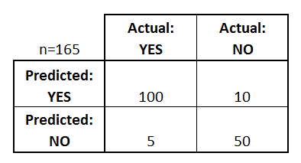
Confusion Matrix
Confusion Matrix: table to describe the performance of a classifier
How many classes are there?
How many patients?
How many predictions of disease?
How many patients actually have the disease?
Example: Test for presence of disease
YES = positive test = True = 1
NO = negative test = False = 0

Slide 72
ROC Curve / AUC
Every email gets a spamminess score.
Choosing a cut-off, this becomes a classification.
How do we choose a cut-off?
How do we evaluate the ranking without choosing a cut-off?
Email Number | Score | True Label
5 | 0.93 | Spam
8 | 0.91 | Spam
2 | 0.84 | Spam
1 | 0.6 | Ham
7 | 0.54 | Spam
3 | 0.22 | Ham
4 | 0.10 | Ham
6 | 0.02 | Ham

Slide 73
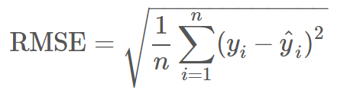
Root Mean Squared Error
Used for regression problems
Square root of the mean of the squared errors
Easily interpretable (in the “y” units)
“Punishes” larger errors

Slide 74
XV. Unsupervised learning
DATA SCIENCE

Slide 75
Types of Machine Learning Problems
generalization
supervised making predictions
unsupervised extracting structure
representation

Slide 76
Types of Machine Learning Problems
continuous categorical
supervised regression classification
unsupervised dimension reduction clustering

Slide 77
UNSupervised Learning
No response variable y, just a set of predictors X
Objective is more fuzzy:
Find groups of observations that behave similarly
Find predictors that behave similarly
Find linear combinations of features that explain most of the variation in the data
Difficult to evaluate how well you are doing
Data is easier to obtain for unsupervised learning since it can be “unlabeled” (i.e., it hasn’t been labeled with a response)
Sometimes useful as a preprocessing step for supervised learning
Common techniques: clustering, principal components analysis

Slide 78
XVI. Cluster Analysis
DATA SCIENCE

Slide 79
Cluster analysis
Q: What is the purpose of cluster analysis?
A: To enhance our understanding of a dataset by dividing the data into groups.
Clustering provides a layer of abstraction from individual data points.
The goal is to extract and enhance the natural structure of the data

Slide 80
The basic K-means algorithm
1) choose k initial centroids (note that k is an input)
2) for each point:
- find distance to each centroid
- assign point to nearest centroid
3) recalculate centroid positions
4) repeat steps 2-3 until stopping criteria met
x₁
x₂

Slide 81
Cluster validation
In general, k-means will converge to a solution and return a partition of k clusters, even if no natural clusters exist in the data.
We will look at two validation metrics useful for partitional clustering, cohesion and separation.

Slide 82
STRENGTHS AND WEAKNESSES
Strengths:
K-means is a popular algorithm because of its computational efficiency and simple and intuitive nature.
Weaknesses:
However, K-means is highly scale dependent, and is not suitable for data with widely varying shapes and densities.

Slide 83
XVII. Dimension Reduction
DATA SCIENCE

Slide 84
Dimensionality reduction
Q: What is dimensionality reduction?
A: A set of techniques for reducing the size (in terms of features,
records, and/or bytes) of the dataset under examination.
In general, the idea is to regard the dataset as a matrix and to decompose the matrix into simpler, meaningful pieces.

Slide 85
Dimensionality reduction
Q: What are the motivations for dimensionality reduction?
A: The number of features in our dataset can be difficult to manage, or even misleading (eg, if the relationships are actually simpler than they appear).

Slide 86
Dimensionality reduction
Q: How is dimensionality reduction performed?
A: There are two approaches: feature selection and feature extraction.
feature selection – selecting a subset of features using an external criterion
feature extraction – mapping the features to a lower dimensional space

Slide 87
Dimensionality reduction
Feature selection is important, but typically when people say dimensionality reduction, they are referring to feature extraction.
The goal of feature extraction is to create a new set of coordinates that simplify the representation of the data.

Slide 88
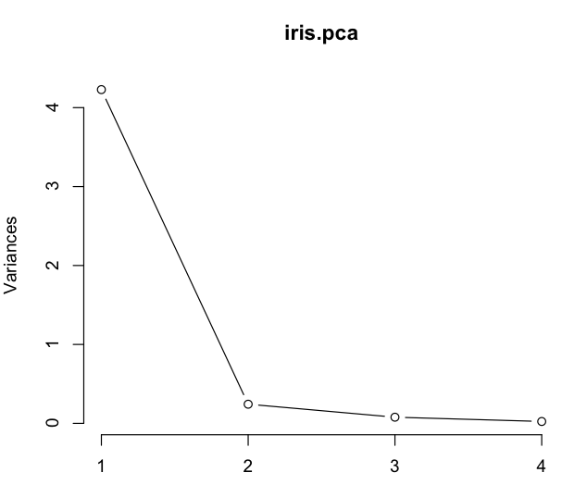
Principal component analysis
NOTE
Looking at this plot also gives you an idea of how many principal components to keep.
Apply the elbow test: keep only those pc’s that appear to the left of the elbow in the graph.

